Slide 1
Summary Report
Project
✅
Pass
❌
Fail
⚠️
Borderline
Paste screenshot
Executive Summary
This report prepared by:

Slide 2
Sample descriptions
✅
Pass
Status
Sample information accurate and complete
❌
Fail
Comments: Enter comments
⚠️
Borderline
Paste screenshot

Slide 3
Chromatin fragmentation check
✅
Pass
❌
Fail
⚠️
Borderline
Status
Smear predominantly between 200-500 bp
Comments:
Enter comments
Paste screenshot; rotate right by 90˚
May need crop and align lane assignments
Copy/paste and align vertical yellow lines on top of gel
Grab vertical yellow lines and align with 200/500 markers

Slide 4
Library size check
✅
Pass
❌
Fail
⚠️
Borderline
Status
Smear predominantly between 150-500 bp
Comments:
Enter comments
Paste screenshot; rotate right by 90˚
May need crop and align lane assignments
Copy/paste and align vertical yellow lines on top of gel
Average Insert size (PE)
Grab vertical yellow lines and align with 200/500 markers
Paste screenshot

Slide 5
Sequencing statistics
✅
Pass
Status
>requested
Status
>50%
❌
Fail
⚠️
Borderline
Sample Id
Genome
Total read Count
Deduplicated %
Complexity
Comments:
Enter comments
Paste & align screenshot
Paste & align screenshot
Paste & align screenshot
Paste & align screenshot

Slide 6
Sample# technical + control
Sample# technical – control
✅
Pass
❌
Fail
Status
Expected
Status
Expected
⚠️
Borderline
Motif 1
Target: CTCF
Moitif 1
Target: IgG
Composite plot
Composite plot
MEME motif
MEME motif
Comments:
Enter comments
Comments:
Enter comments

Slide 7
Sample# + control
Sample# – control
✅
Pass
❌
Fail
Status
Expected
Status
Expected
⚠️
Borderline
Motif 1
Target:
Moitif 1
Target:
Composite plot
Composite plot
Not performed
Not performed
MEME motif
MEME motif
Comments:
Enter comments
Comments:
Enter comments

Slide 8
PEGR Archived example 1
PEGR Archived example 2
✅
Pass
❌
Fail
Status
Expected
Status
Expected
⚠️
Borderline
Motif 1
Target:
Moitif 1
Target:
Composite plot
Composite plot
Not performed
Not performed
MEME motif
MEME motif
Comments:
Enter comments
Comments:
Enter comments

Slide 9
Assay example #####
✅
Pass
Assay example #####
❌
Fail
Status
Expected
Status
Expected
⚠️
Borderline
Motif 1
Target:
Moitif 1
Target:
Composite plot
Composite plot
5 bp periodicity
Not performed
Not performed
MEME motif
MEME motif
Comments:
Enter comments
Comments:
Enter comments

Slide 10
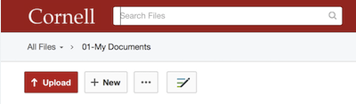
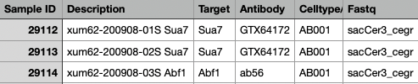
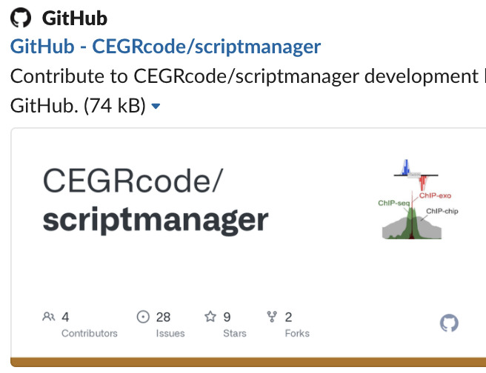
Datafiles & Analysis
We provide the raw FastQ files, raw BAMs, filtered BAMs from the sequencing results to you together with a copy of this summary report. The files are available in a shared Cornell Box folder for 30 days. A link will be sent to you. We keep the metainformation and raw files for you as a part of this service.
Here are instructions to use Filezilla if you want a GUI interface
Here are instructions to use the command line
EXAMPLE
Dr. Will Lai has developed a GUI interface for some standard approaches to analyzing ChIP-exo data. You can download the software from his repo - https://github.com/CEGRcode/scriptmanager.
A "ScriptManager-Tutorial.docx" is available with step-by-step screenshot tutorials.
Here are recordings of Dr. Lai’s prior epigenomics training sessions. Download materials are available but videos will require BioHPC account login which is free to members of Cornell community.
Please let us know if you would like to schedule a meeting for a consultation on your data and analyses.

